Slide 1
Customer Segmentation
Analyzing Amazon's Bestselling Books
Team Data Pirates
-Akash kotha
-Y.Sasivadan

Slide 2
Introduction:
This presentation explores customer segmentation of Amazon's bestselling books, focusing on the methodology, insights gathered, and the impact of these segments on business strategies.

Slide 3
Problem Statement:
How can we segment Amazon book buyers based on their purchasing behavior, book preferences, and engagement (ratings, reviews, and price sensitivity)? By identifying distinct customer groups, Amazon and publishers can improve recommendations, boost sales, and tailor marketing strategies effectively.

Slide 4
Importance of segmentation in marketing
Segmentation is crucial in marketing as it allows for tailored communications and personalized marketing strategies. For Amazon, understanding its book-buying customers enables more effective recommendations, targeted advertising, and promotional strategies that resonate with specific segments. This not only improves customer satisfaction but also enhances sales and loyalty.

Slide 5
Objectives and Technologies and Tools Used:
Analyze buying patterns of customers based on book attributes (genre, price, reviews, ratings, and year).
Segment customers using machine learning techniques to identify distinct buyer groups.
Identify key trends in bestseller books across different customer segments.
Provide actionable insights to publishers and sellers for improving book visibility and sales.
Data Processing & Analysis: Python (Pandas, NumPy, Matplotlib, Seaborn),Mysql
Visualization & Business Intelligence: Tableau for creating interactive dashboards
Machine Learning Algorithms:
Clustering: K-Means Clustering for customer segmentation

Slide 6
Data Insights

Slide 7
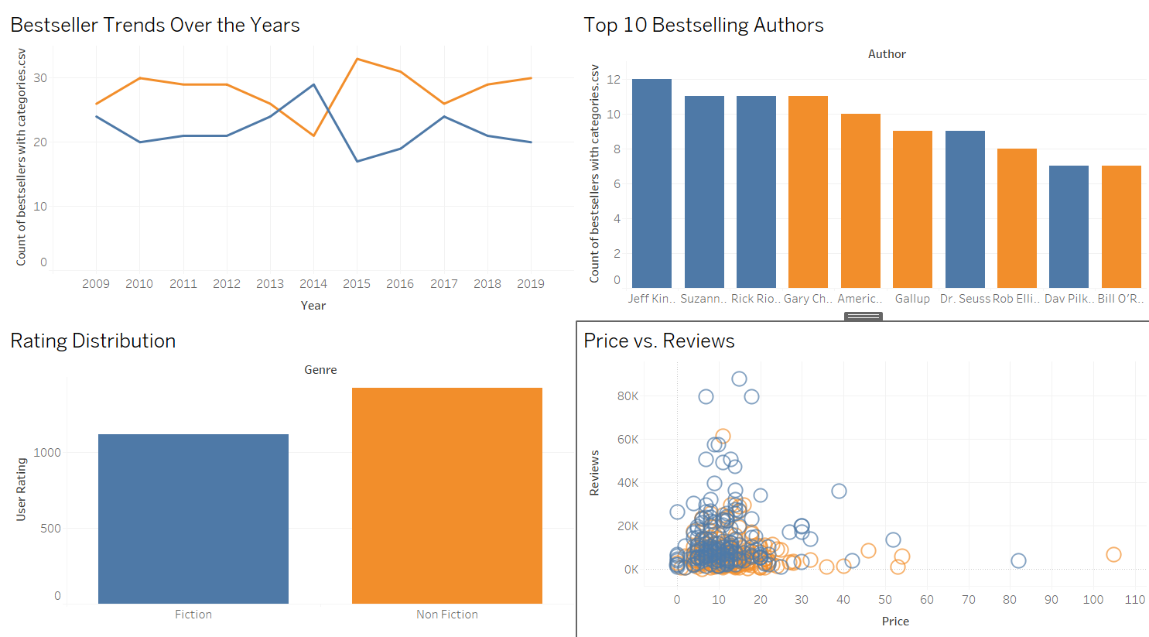

Slide 8
Expected Outcomes:
Well-defined customer segments based on purchasing behaviors.
Insights into price sensitivity, genre preferences, and rating impact on book sales.
Data-driven recommendations for personalized book marketing and promotions.

